Slide 1
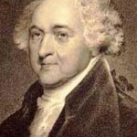
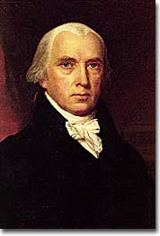
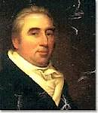
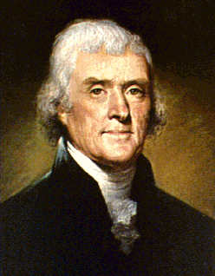
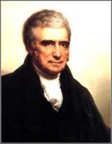
Marbury v Madison 1803
James Marbury
John Adams
James Madison
The Key Participants
John Marshall
Thomas Jefferson

Slide 2
Adams Presidency
Before the election of 1800 Federalist control the government
John Adams is President and his Secretary of State is John Marshall
In 1800 Adams loses the Presidency to Thomas Jefferson
And both Houses of Congress will be controlled by Jeffersonian-Republican
Loser

Slide 3
Midnight Judges
Adams sees that his idea for America is about to be completely undermined by T.J. and his political party.
So, in the 4 months between the election and Jefferson’s inauguration Adams and Congress create courts and appoint Federalist Judges to them.
All of the commissions are approved by Congress and signed by J.A.
But, his Secretary of State can’t deliver them all!
Marbury is appointed to a be a judge in Washington, D.C. but never gets his commission

Slide 4
Transitioning to Jefferson
The Judiciary act of 1789
AdAms out the Door
Creates lower courts than the Supreme Court and
Creates a new power for the Supreme Court, “A Writ of Mandamus
The courts can issue a Writ to force some in the executive branch to act
In one of his last acts as President Adams appoints John Marshall to be the Chief Justice of the Supreme Court
John Marshall: A Virginian who is Thomas Jefferson’s third cousin, yet both men hate each other.

Slide 5
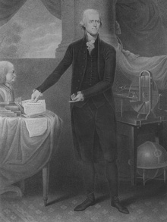
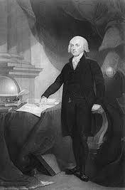
Tom says to James “do not deliver the commissions to those federalist pigs” *
1801 Jefferson takes the oath of office from his cousin john marshall
1801 new secretary of state james madison finds a stack of commisions for judges that marshall was unable to deliver

Slide 6
What to do what to do what to do
Marbury sues Madison
Case goes to the Court
So the case of Marbury v Madison will be heard by the Supreme Court.
Marbury is suing for a Writ of Mandamus force Madison to make him a judge
Marshall has three choices
Tell Madison to deliver the commisions
Deny Marbury a commission a that is rightfully his
Come up with something else

Slide 7
Yes for a year!
Jeffersonian – Republicans in Congress send the Supreme Court home for a year!

Slide 8
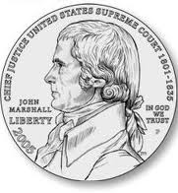
A Solution!!!
Marshall hands down the ruling in 1803
One, yes he has a right to be a judge
Two, yes Jefferson and Madison are awful people
But, “I can’t help you”

Slide 9
Judicial review
Marshall finds that the power created by Congress in the Judicary Act of 1789, Writ of Mandamus is UNCONSTITUTIONAL. So he can’t help out Mr. Marbury
Jefferson and Madison win!

Slide 10
NOT SO FAST

Slide 11
Separation of powers established
IS THE POWER TO FIND A LAW UNCONSTITUTIONAL IN THE CONSTITUTION?
So Marbury doesn’t get to be a Judge, that should make Jeff and Mad happy.
But Cousin Marshall just expanded the power the Supreme Court at the expense of the other two branches.
Tommy is not happy
NO
REALLY IT ISN’T IN THERE. IT IS IMPLIED BY CHECKS AND BLANCES BUT IT IS NOT SPECICALLY STATED

Slide 12
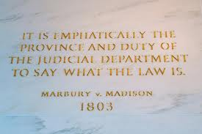
A real supreme supreme court

Slide 13
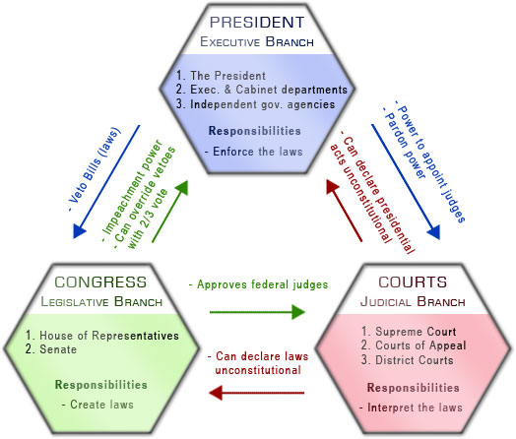
After Marbury v madison 1803

Slide 14
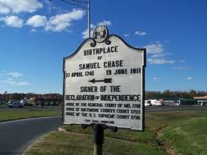
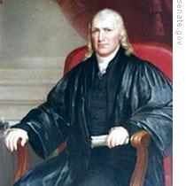
Impeachment of Samuel Chase
House of Reps impeaches for “High Crimes and Misdemeanors
Senate acquits!
Importance: Impeachment never again used to try to control the INDEPENDENT JUDICIARY

